Slide 1
ANN for Concrete Strength prediction

Slide 2
Different Algorithms as optimizers
Activation function: sigmoid
Loss function: MSE
Algorithms | r-squared
Lm (matlab) | 0.64
adagrad | 0.5627
adam | 0.5986
nadam | 0.6035
rmsprop | 0.5987
sgd | 0.5837

Slide 3
Levenberg - Marquardt Algorithm
J : Jacobian matrix
δ: 𝝎(i+1) - 𝝎(i)
ƛ: dumping factor
Gauss-Newton Algorithm
Steepest descent

Slide 4
Different Loss Functions
Algorithm: ADAM
Activation function: sigmoid
Loss function | r-squared | Std. of r^2 | mse | Std. of mse
MAPE | 0.0359 | 0.02 | 48.87 | 1.28
MAE | 0.5905 | 0.0136 | 20.76 | 0.66
MSLE | 0.1006 | 0.7094 | 45.35 | 35.19
MSE | 0.5999 | 0.0147 | 20.28 | 0.68
Notes:
Try different activation function

Slide 5
ANN model for concrete strength prediction
Input
Output
Number of Layers: 4
Number of neurons on each layer : 32
Activation Function : hyperbolic tangent

Slide 6
Gradually Increasing Ratio of Training Set
Keeping 20% of entire dataset as testing set
Gradually increasing ratio of training set from 4%to 80% of entire dataset
Testing set |  | Training set
20%
4% - 80%

Slide 7
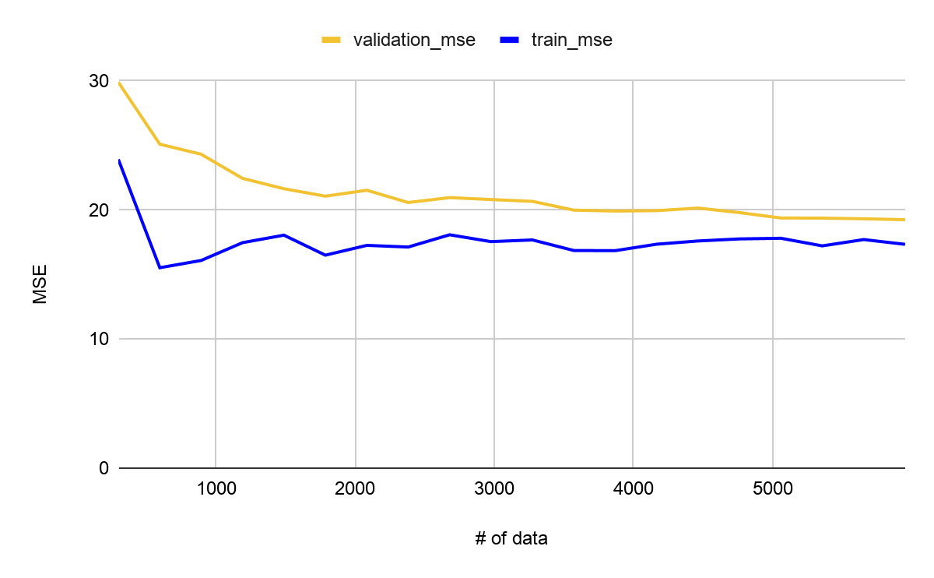
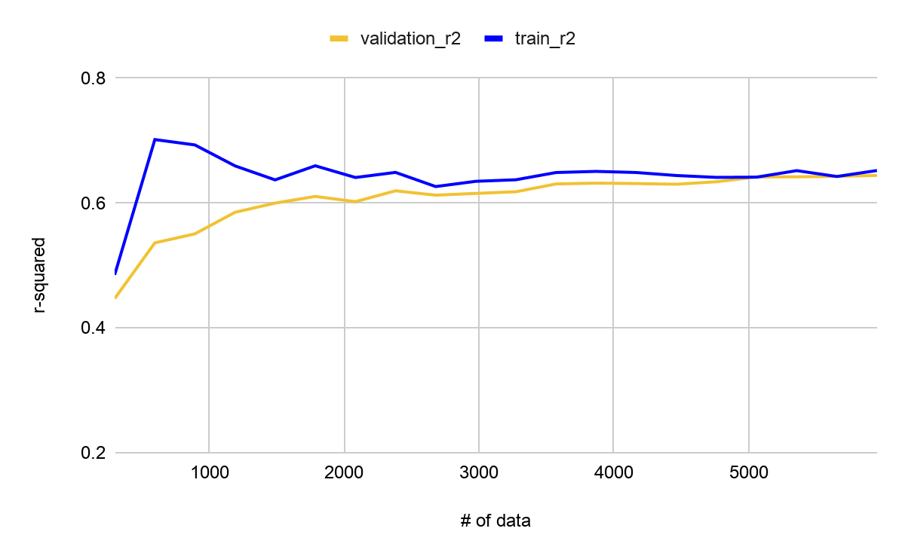
Gradually Increasing Ratio of Training Set

